Slide 1
Introduction to x86 Assembly Language
Instructor: john ortiz
Lecturer III utsa
stego@satx.rr.com
CS 3843 Computer Organization

Slide 2
Addressing Modes
An Addressing Mode is the way data is accessed
Explicit – specified directly in instruction
mov eax, ebx ; registers are explicitly listed
Implicit – understood by virtue of instruction
pop eax ; we’re using esp but it’s not specified by “pop”
Note:
Intel format is: < --- we will use this one
opcode dst operand, src operand
AT&T format is:
opcode src operand, dst operand
Do YOU see “esp”
anywhere in the
Instruction???

Slide 3
Addressing Modes
Immediate – data in the instruction itself
The data is actually in the code space with the instruction
Puts the value 0xCC into ecx
mov ecx,0CCh ; B9 CC 00 00 00
The 0xCC is a 4-byte number in little endian format
Register – data is in the register
copies the contents of esp into ebp
mov ebp, esp ; 8B EC
memory is not accessed, so it’s very fast!
Some instructions use some registers implicitly
div ecx ; F7 F1
Divides the 64-bit value in edx:eax by ecx
eax has quotient, edx has remainder
edx, eax are the implicit registers!

Slide 4
Addressing Modes
DWORD ECX1=5, EDX1=1, EAX1=1;
__asm mov ecx, 100; // immediate
__asm mov eax, 25972;
__asm mov edx, 0;
__asm div ecx; // implicit edx and eax
__asm mov ECX1,ecx; // register to register
__asm mov EDX1,edx;
__asm mov EAX1,eax;
printf("ecx=%d, eax=%d, edx=%d\n\n", ECX1, EAX1, EDX1);
ecx=100, eax=259, edx=72

Slide 5
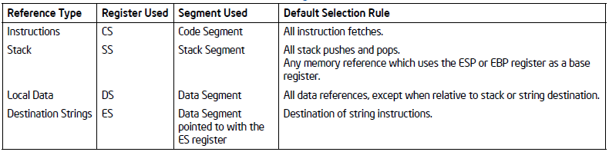
Addressing Modes - Memory
Memory operands specified with a segment selector and an offset
90+% of the time, the segment selector is implied!!!
mov es:[ebx], eax ;
puts contents in eax into memory pointed to by es:[ebx]
ebx is the offset, most often don’t even see the es:
mov [ebx], eax ; < --- typical format

Slide 6
Addressing Modes - Memory
Instructions accessed from code segment
esp cannot be an index register
esp and ebp will use the stack segment
The rest will use the data segment by default
It is possible to do a segment override
Absolute Address:
Offset from zero
Relative Address:
Offset from current EIP
Since we are not WRITING code, we will see the “rules” in action rather than having to remember them all at once

Slide 7
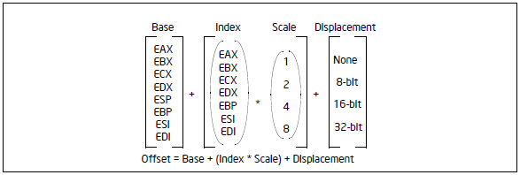
Addressing Modes - Memory
Several ways to specify an offset
Made up of the following components:
Displacement – 8, 16, or 32 bit value
Base – value in the register
Index – value in a register
Scale Factor – 2, 4, or 8 which is a multiplication factor for the index
When you do the calculation, the result is called the “Effective Address” < --- important term

Slide 8
Addressing Modes - Memory
Addressing Mode formats :
Displacement only – called absolute addressing
jmp 0x70605040 ; EA 40 50 60 70 34 12
Jump to the far address specified: jmp 1234:70605040
Could be called a “Load eip”
This specific form is rarely used
jmp [0x70605040] ; ff 25 40 50 60 70
Get the contents of 0x70605040 and jmp to that address
Assume: 0x70605040: 22 28 40 00 THEN eip = 0x00402822 and program execution continues at that address
This is used for jump tables, like for a switch statement
mov eax,[0x3456ABCD] ; a1 CD AB 56 34
Contents of memory location specified place in eax, 4 bytes at a time
0x3456ABCD: 12 34 56 78 --- eax = 0x78563412

Slide 9
Addressing Modes - Memory
Addressing Mode formats :
Base – indirect offset to memory with a register
mov [eax],ebp ; 89 28
Put value of ebp into the memory address pointed to by eax
Assume eax = 0x200f0, ebp = 0x01234567
After the instruction, memory will look like this:
0x000200f0: 67 45 23 01

Slide 10
Addressing Modes - Memory
Addressing Mode formats :
Base + Displacement
Arrays with element sizes other than 2, 4, 8
Used as an index into an array - displacement is static offset of the array and base registers holds the array element
Access a field of a record – base register holds the address of the record and the displacement is the static offset into a field
mov edi,[ebp+0x8] ; 8b 7d 08
Value of ebp + 8 is the address, get contents and put in edi
Assume ebp = 0x000200f0
Assume 0x000200f0 67 45 23 01 98 87 76 65 54 43 32 21
After the instruction, edi = 0x21324354

Slide 11
Addressing Modes - Memory
Addressing Mode formats :
Base + Displacement
In this case the displacement is only 1 byte, but can be negative
mov eax,[ebp-0x8] ; 8b 45 f8
mov eax,[ebp-0x238] ; 8b 85 c8 fd ff ff
ebp:0012b8f4, ebp-0x238=0012b6bc
Assume 0012b6bc: 30392600
Then eax=0x00263930

Slide 12
Addressing Modes - Memory
Addressing Mode formats :
(Index * Scale) + Displacement
Access arrays with 2, 4, 8 byte element sizes
Displacement is beginning of array, the index holds the subscript, and the scale factor gets it to the right address
jmp [edx*4+0x340c6f54] ; ff 24 95 54 6f 0c 34
Assume edx = 0x00000003, then 3 * 4 = 0x0c
0x340c6f54 + 0x0c = 0x340c6f60
Do we jump to 0x340c6f60? NO! Jump to contents of 0x340c6f60
Assume: 0x340c6f60 22 28 40 00 THEN eip = 0x00402822
mov ax,[esi+eax*2] ; 66 8b 04 46
Size is 16 bits, esi is base, eax is index
66 is a size override, indicating it is WORD, not DWORD
Assume: esi= 0x7FF0FB34, eax=0x10, what is the Effective Address (EA)?

Slide 13
Addressing Modes - Memory
Addressing Mode formats :
(Index * Scale) + Displacement
Access arrays with 2, 4, 8 byte element sizes
Displacement is beginning of array, the index holds the subscript, and the scale factor gets it to the right address
jmp [edx*4+0x340c6f54] ; ff 24 95 54 6f 0c 34
Assume edx = 0x00000003, then 3 * 4 = 0x0c
0x340c6f54 + 0x0c = 0x340c6f60
Do we jump to 0x340c6f60? NO! Jump to contents of 0x340c6f60
Assume: 0x340c6f60 22 28 40 00 THEN eip = 0x00402822
mov ax,[esi+eax*2] ; 66 8b 04 46
Size is 16 bits, esi is base, eax is index
66 is a size override, indicating it is WORD, not DWORD
Assume: esi= 0x7FF0FB34, eax=0x10, what is the Effective Address (EA)?
0x7FF0FB34 +0x20= 0x7FF0FB54
Assume: 0x7FF0FB54: 00 11 22 33 --- ax=0x1100

Slide 14
Addressing Modes - Memory
Addressing Mode formats :
Base + Index + Displacement
Supports a 2-dimensional array
lea ecx,[ecx+eax+0xc] ; 8d 4c 01 0c
Assume: ecx=0x00224488, eax=0x100
EA = 0x00224594
The “lea” instruction is Load Effective Address --- ecx=0x00224594
Base + (Index * Scale)
mov ecx,[eax+ecx*4] ; 8b 0c 88
ecx = contents of eax+ecx*4
Base + (Index * Scale) + Displacement
Supports a 2-dimensional array with element sizes of 2, 4, 8
mov eax,[eax+ecx*4+0xe10] ; 8b 84 88 10 0e 00 00
eax = contents of eax+ecx*4+0x00000E10

Slide 15
Addressing Modes - Memory
NOTE: NONE of the addressing modes are in any way restricted to the examples given
The examples are merely ways the compiler can efficiently translate a high-level data structure into assembly language
Just because it is Base + Displacement does NOT mean it MUST be indexing a high-level array
The compiler can choose that for any operation

Slide 16
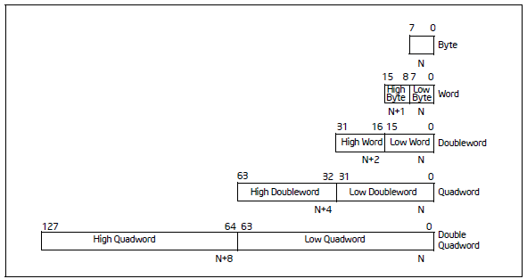
Data Types
Integer ( 1, 2, 4, 8, 16 bytes )
Floating Point
A few others – we may see here and there

Slide 17
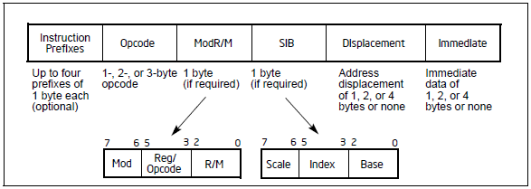
Instruction Format
Machine code format not important to us …
OTHER THAN to be able to READ it and look it up
That skill IS NEEDED sometimes to understand the code

Slide 18
Instruction Prefixes
Group 1 – Lock and Repeat
LOCK
0xF0
REPNE/REPNZ – Repeat Not Equal OR repeat Not Zero
They mean the same thing, two names, one meaning
Applies to string and I/O operations
MOVS, CMPS, SCAS, LODS, STOS, INS, and OUTS
oxF2
REP/REPE/REPZ – Repeat Equal OR Repeat Zero
Same meaning
Applies to string and I/O operations
MOVS, CMPS, SCAS, LODS, STOS, INS, and OUTS
0xF3

Slide 19
Instruction Prefixes
Group 2 – Segment Override
CS Segment Override
0x2E
SS Segment Override
0x36
DS Segment Override
0x3E
ES Segment Override
0x26
FS Segment Override
0x64
GS Segment Override
0x65
Branch Hints – compiler hints to CPU for optimization
0x2E – branch not taken
0x3E – branch taken

Slide 20
Instruction Prefixes
Group 3 – Operand Size Override
Switch between 16-bit and 32-bit operand sizes
0x66
Group 4 – Address Size Override
Switch between 16-bit and 32-bit addressing
0x67

Slide 21
Categories of Instructions
Data transfer
Binary arithmetic
Decimal arithmetic
Logical
Shift and rotate
Bit and byte
Control transfer
String
I/O
Enter and Leave
Flag control
Segment register
Miscellaneous

Slide 22
Instruction Notes
We will NOT cover ALL instructions
The important skill is to be able to look up what you need
You would never be able to simply learn all these instructions by reading about them on the slides
( I wouldn’t be able to either, so waste of time to cover all )
Many of the instructions affect the flags
I am not going to attempt to point out every instruction and every flag set --- be able to look it up!
As you get familiar by tracing through code, you will get a sense of which instructions affect what flags
Still, look it up!

Slide 23
Instruction Notes
By test time you WILL be expected to understand how some of the instructions work w/o the book
These would be the very common instructions
Example: mov eax, ebx
You should not need to look that up in the book!
I cannot EMPHASIZE this enough:
You CANNOT learn this material without doing the homework / labs yourself!!!

Slide 24
Instruction Notes
Having said that, you CAN learn working in groups, helping each other, taking turns looking stuff up
Watching your lab partner the entire time won’t help, you need to do it sometimes and let him/her watch
You CAN SHARE what you turn in
Work in a group and turn in one assignment vetted by the group
On the exam, YOU WILL have to do it yourself
These slides are intended to
Give you a little overview
Provide a quick reference
Give you a chance to ask me questions
They will not replace your work and time

Slide 25
Data Transfer Instructions
Move bytes, words, double words, and quad words between registers and/or to/from memory
Sub-Groups
General data movement
Exchange
Stack based instructions
Type conversions

Slide 26
Data Transfer Instructions
MOV instructions
mov [address], eax
mov eax, [address]
Conditional MOV
Check status of flags and mov if condition is met
cmovc eax,ebx < --- only one example, there are many
Move if carry flag = 1
Not very common – I have rarely seen them
MOVSX
Move with sign extend
mov ebx,al (assume al = 0xFE, i.e. -2)
ebx = 0xFFFFFFFE
MOVZX
Move with zero extend – clears upper bits of a register

Slide 27
Data Transfer Instructions
Exchange
xchg eax,ebx
Swaps the contents of these two registers
How is that different than
mov eax, ebx ????
xadd [ecx],eax
eax = [ecx], [ecx]=[ecx]+eax
ecx=341a2ff4: 1d 00 00 00
eax=00000001
341a2ff4: 1e 00 00 00, eax=0000001d

Slide 28
Data Transfer Instructions
Stack Manipulation
push eax
esp = esp - 4
mov [esp], eax
pop eax
mov eax, [esp]
esp = esp + 4
pusha / popa
Push all registers
Pop all registers
NOTE: Careful about viewing stack graphs in manual
I draw lowest address at the top – Intel Manual tends to show lowest address at bottom!!!

Slide 29
Data Transfer Instructions
Type Conversion
CBW – Convert Byte to Word
CWD – Convert Word to Double
0x66 0x99 – size override prefix since opcode is 0x99 for cdq
CDQ – Convert Double to Quadword
0x99

Slide 30
Binary Arithmetic
These all affect the main flags (CF, SF, OF, ZF)
ADD/ SUB
Adds the source operand to the destination operand and stores the result into the destination operand
add edx,eax
edx = edx + eax
INC/ DEC
Increments or decrements the destination operand by one
inc edx
edx = edx + 1

Slide 31
Binary Arithmetic
CMP
Compares the two operands by performing a subtraction and setting the flags according to the result
cmp eax,ebx
performs subtraction eax – ebx, result not stored
Sets appropriate flags
ZF =1 if result is zero, cleared otherwise
OF=1 if result exceeds signed range
Example for a single byte
al=0x80, bl=0x01 , 0x80 – 0x01 = 0x7f … -128 – 1 != 127
SF=1 if result is negative (i.e. msb = 1)
CF=1 if borrow is required (i.e. ebx > eax)
AF / PF set/cleared as well

Slide 32
Binary Arithmetic
NEG
Gets the two’s complement of the operand
Operand is both source and destination
Note: “NOT” gets the one’s complement
Performs a “NOT” operation and adds 1
neg eax
Gets the two’s complement of eax and stores it in eax

Slide 33
Decimal Arithmetic
Add / Sub on Binary Code Decimal
We’ll examine if needed
Not very common

Slide 34
Logical Operations
NOT
Invert all the bits
One’s complement
(N) AND
All inputs must be 1 for result to be one
Think multiplication: 1 * 1 * 1 * 1 * … if any one of the inputs is a zero, the result is zero
For NAND, same thing except result is inverted
If any one of the inputs is a zero, the result is a one

Slide 35
Logical Operations
(N) OR
If any input is a one, the result is a one
Think addition, but the result is either zero or not zero
In order for the final result to be zero, all inputs must be zero
For NOR, same thing except result is inverted
In order for the final result to be one, all inputs must be zero
(XOR / XNOR)
If both inputs are the same, the result is zero
Think even vs. odd – even number of ones, result is zero
XNOR is also called “equivalence” because if the inputs are the same , the result is a one

Slide 36
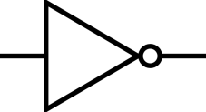



Logical
Bitwise logical operations
Operates on each bit as specified below
NOT( not eax )
! 0 = 1
! 1 = 0
AND ( and eax, ebx ) OR( or ebx, ecx )
0 & 0 = 0 0 & 0 = 0
0 & 1 = 0 0 & 1 = 1
1 & 0 = 0 1 & 0 = 1
1 & 1 = 1 1 & 1 = 1
XOR ( xor eax, eax )
0 & 0 = 0
0 & 1 = 1
1 & 0 = 1
1 & 1 = 0
WHY would you do that!!!???

Slide 37
Logical - Digression
A brief look at the hardware that makes a computer work is based on the logical functions:
NOT
inverter
(N) AND
Enable / disable - (a one on one input enables the other)
Mask bits: AND eax with 0x0000000F and all bits except bottom 4 are zero – i.e. masked off
(N) OR
Enable / disable - (a zero on one input enables the other)
Exclusive-OR (XOR) / Exclusive-NOR (XNOR)
Controllable inverter – (a one on one input inverts the other, a zero on one input does not)

Slide 38
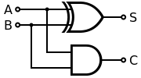
Logical - Digression
For binary arithmetic, XOR is an adder
0 + 0 = 0; 0 xor 0 = 0
0 + 1 = 1; 0 xor 1 = 1
1 + 0 = 1; 1 xor 0 = 1
1 + 1 = 2; 1 xor 1 = 0
Wait! 2 is not equal to zero!
But there is no “2” in binary, so it is expressed as 10
Soooooo, the last digit is a ZERO as in the 1 xor 1
The 1 in the 2’s place is the carry out of adding 1 + 1
1 + 1 = zero, carry the one ➔ 10
Just like in decimal arithmetic: 1 + 9 = ten == 0 carry the 1 → 10
We can generate a carry in hardware by AND’ing the two inputs
When they are both one, the result is a 1
1 and 1 = 1

Slide 39
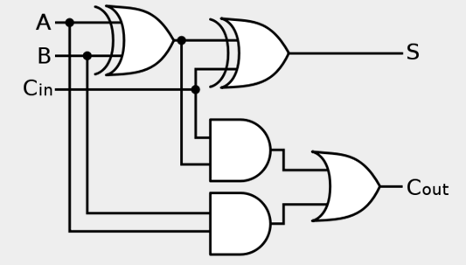
Logical - Digression
The prior circuit was a one-bit half adder because it did not allow for a carry in
Adding a carry in and a little extra circuitry, we construct a one-bit full adder as shown below

Slide 40
Logical - Digression
For multiple bits, cascade them together in parallel
Shown is a 4-bit full adder
But what about subtraction?
Of course we can build a subtractor
But better is to invert the sign of the
B input (i.e. neg B)
Taking two’s complement requires
inverting all the bits and adding one
XOR is a controllable inverter

Slide 41
Logical - Digression
Initial carry in is the Add One
But what about subtraction?
Tie the first carry in to an
“Add/Sub” signal
If that is a ONE, all the bits
will be inverted and
we will add the negative

Slide 42
Shift and Rotate
SAL/ SAR
Shift Arithmetic Left / Right
For signed numbers – it preserves the sign
-7 = 11111001 SAR -- > -4 = 11111100 CF=1
11111100 SAR -- > 11111110 CF=0
SHL/ SHR
Shift Logical Left / Right
01011101 SHL -- > 10111010 CF=0
10111010 SHL -- > 01110100 CF=1
SAL and SHL perform exact same operation!
In both cases, CF gets last bit shifted out
Count restricted to range of 0 to 31
Why would you shift by a huge number anyway?

Slide 43
Shift and Rotate
ROR/ ROL
Rotate Right / Left
Same as shift except that the bit shifted out is shifted in
10100110 ROR -- > 01010011 CF=0, ROR -- > 10101001 CF=1
10100110 ROL -- > 01001101 CF=1, ROL -- > 10011010 CF=0
RCR/ RCL
Rotate Right / Left through carry
10100110 CF=1 RCR -- > 1 1010011 CF=0, RCR -- > 0 1101001 CF=1
There is no arithmetic rotate

Slide 44
Bit and Byte
BT
Bit Test
BTS
Bit Test and Set
BTR
Bit Test and Reset (set to zero)
BTC
Bit Test and Complement
BSF / BSR
Bit Scan Forward / Reverse
SETCC
Set byte on condition
TEST
Ands two operands and sets flags SF,ZF, PF accordingly

Slide 45
Bit and Byte
BT
Bit Test
BTS
Bit Test and Set
BTR
Bit Test and Reset (set to zero)
BTC
Bit Test and Complement
BSF / BSR
Bit Scan Forward / Reverse
SETCC
Set byte on condition
TEST
Ands two operands and sets flags SF,ZF, PF accordingly
NOT “Compliment”!!!
The CPU doesn’t test the bit and then say, “Hey, you look great today!” or “You do NOT look fat in those jeans!”

Slide 46
Bit and Byte
BT
Bit Test
BTS
Bit Test and Set
BTR
Bit Test and Reset (set to zero)
BTC
Bit Test and Complement
BSF / BSR
Bit Scan Forward / Reverse
SETCC
Set byte on condition
TEST
Ands two operands and sets flags SF,ZF, PF accordingly
NOT “Compliment”!!!
The CPU doesn’t test the bit and then say, “Hey, you look great today!” “You do NOT look fat in those jeans!”
Sorry, just a little bit of humor.

Slide 47
Control Transfer
Unconditional Transfer
JMP
Loads EIP with the address and begins execution
CALL/ RETN
Call pushes address of next instruction onto the stack
Loads EIP with the address and begins execution
Return loads EIP with the contents of the top of the stack
INT/ IRET
Software Interrupt instructions
More on these later …

Slide 48
Control Transfer
CALL/ RETN in detail
DWORD result;
int var = 256;
result = func ( 10, var );
--------- What Happens ---------
push var
push 10
call func
pushes address of the mov below onto the stack
jumps to address of func
performs function, return value in eax
retn
pops address of move from the stack
jumps to that address
mov result, eax

Slide 49
Control Transfer
Conditional Transfer
jCC – jmp on condition
Often called branch instructions
Uses relative addressing
Most unconditional jumps do too
It is relative to the NEXT instruction!!!
0x1000 jne label;
06823170 75 f4 jnz short_6823166
--- target address ---
06823166 31 c0 xor eax,eax
0x166-0x170 = 0xf6, BUT OPERAND “f4” == -12
CPU calculates relative offset from 06823172, since EIP already incremented
This jump instruction is 2 bytes long (some are 5)
NOTE: the “signed” conditional jumps take into account the overflow flag!!!
Jumping Back

Slide 50
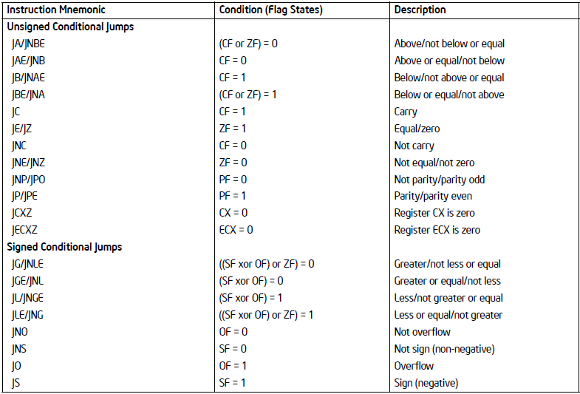
Control Transfer

Slide 51
Control Transfer
LOOP
dec ecx
tests condition, if ecx != 0, loop to address
If ecx == 0, terminate loop
If you set ecx to zero it will loop 4+ BILLION times! (2^32)
xor ecx, ecx
loop --- will dec ecx to 0xFFFFFFFF before testing condition
LOOPE / LOOPZ ( loop if Z flag set )
Same as loop except they also test ZF
If ecx != 0 but ZF = 0, terminate loop
LOOPNE / LOOPNZ ( loop if Z flag reset, i.e. ZF=0 )
Terminate loop if ZF=1 (or ecx == 0)

Slide 52
String
MOVS- Move string
mov ES:[edi],DS:[esi]
DS can use a segment override
CMPS– Compare string
cmp ES:[edi], DS:[esi]
Sets flags accordingly
SCAS– Scan string
cmp ES:[edi], eax
Set flags accordingly

Slide 53
String
LODS– Load string
mov eax,DS:[esi]
STOS– Store string
mov ES:[edi], eax
In ALL cases, both edi and esi are incremented or decremented by the element size
Size can be 1, 2, 4, or 8 bytes
Increment or decrement depends on direction flag
DF=0 --- Increment
DF=1 --- Decrement

Slide 54
I/O
IN
Input from port
OUT
Output to port
INS
Input string from port
OUTS
Output string to port
Unless you’re kernel debugging, you will not see these in user land
They are restricted

Slide 55
Enter and Leave
ENTER/ LEAVE
Set up / tear down a stack frame for function calls
Don’t see Enter used much
We’ll look at specific steps taken later

Slide 56
Flag Control
STC
Set Carry Flag
CLC
Clear the Carry Flag
CMC
Complement the Carry Flag
Want to guess at what those instructions do?
CLD/ STD
Clear / Set Direction Flag – you choose direction!
CLI/STI
Clear / Set Interrupt Flag
LAHF / SAHF
Load flags into AH, Set flags with AH

Slide 57
Flag Control
PUSHF / PUSHFD
Push (E)FLAGS onto the stack
PUSHF is 16 bits (FLAGS register) and PUSHFD is 32 bits (EFLAGS register)
POPF/POPFD
Pop (E)FLAGS from the stack

Slide 58
Segment Registers
LDS/LES/LFS/LGS
load far pointer using DS/ES/FS/GS

Slide 59
Miscellaneous
LEA
Load Effective Address
We’ve discussed this one, any questions?
This one is VERY COMMON – might as well learn it now
NOP
No OPeration – does nothing but waste clock cycles
0x90 is the hex opcode
Learn it NOW! Memorize it, don’t forget.
I’m gonna ask you 20 years from now what the hex code for NOP is and you should STILL know it!
It is a great space filler

Slide 60
Random Number Generator
RDRAND
Gets random number from the hardware
CF flag set if successful, other flags cleared
OF, SF, ZF, AF, PF
RDSEED
Also gets a random number from the hardware
Uses non-deterministic Random Bit Generator
CF = 1 flags success, other flags cleared

Slide 61
Instruction Set
Many more instructions
Need to get used to addressing modes
We’ll do one here, then progress to in-class lab exercises

Slide 62
IDA Pro Example – Source Code
void main(int argc, char *argv[])
{
static DWORD findMeInFile = 0x1234FEDC;
static DWORD *ptrSecretData;
char *ptrC;
DWORD mainResultD = 0, curEsp, curEip;
__asm call NextInstr;
__asm NextInstr: pop eax;
__asm mov curEip, eax;
printf("\n\n MAIN: Eip=%08x, &mainResultD = %p, &func1=%p, &findMeInFile=%p\n\n",
curEip, &mainResultD, func1, &findMeInFile);
// call the first function
mainResultD = func1();

Slide 63
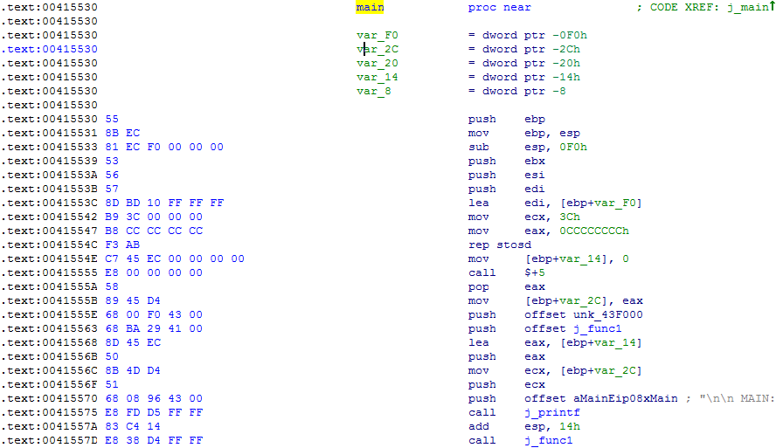
IDA Pro Example
Set up Stack Frame
Save Registers
Stack Guard
( INT slide! )
Set local var=0
Get EIP into local var
Set up and call printf
Call func1

Slide 64
IDA Pro Demo Time
Will the real IDA Pro please stand up!

Slide 65
Questions & Comments

Slide 66
References
Complete Intel Manuals
http://www.google.com/url?sa=t&rct=j&q=&esrc=s&source=web&cd=2&ved=0ahUKEwjx4aCTvbbKAhWFnIMKHQPeCJEQFggiMAE&url=http%3A%2F%2Fwww.intel.com%2Fcontent%2Fdam%2Fwww%2Fpublic%2Fus%2Fen%2Fdocuments%2Fmanuals%2F64-ia-32-architectures-software-developer-instruction-set-reference-manual-325383.pdf&usg=AFQjCNHypw9o8DOotEaFLpOIpkWm0xKU8w&sig2=_tXqGdILtMhKeUQU4Q7v3g&bvm=bv.112064104,d.amc

